Slide 1
Transfers In
Karen Gore
October 2016

Slide 2

Transfers In
Contents
The Right to Transfer In
Transfer In from Overseas Pension Schemes
Our Confirmation Requirements
Drawdown Arrangements Pre-April 2015
Transfers In to BlackRock Retirement Income Account
Accepting Uncrystallised and Crystallised monies
Money Purchase Annual Allowance
Can a member change their mind?
Transfer In and Enhanced Protection
Block Transfers
Summary for Contract Based Schemes
Quiz

Slide 3
The Right to Transfer In
Any scheme can accept a transfer in from a Registered Pension Scheme
But it’s at the discretion of provider/trustees whether they will accept the transfer in (with the exception of Stakeholder)
DC transfers to DC are normally acceptable
DB transfers to DC we will always discourage (FCA’s general position on DB to DC transfers is that they cannot normally be justified due to loss of guarantees – in the past huge review & large numbers compensated)
The transferring scheme must ensure a member has received advice if transferring out of a DB scheme to a DC scheme that can provide flexible benefits if the transfer value is > £30,000, or where the member has DC benefits that contain guarantees such as guaranteed annuity rates
GPP
DB transfers in - we insist member obtains advice from an authorised financial adviser
Stakeholder
We must accept any transfer in from a Registered Pension Scheme unless accepting the transfer would affect the Stakeholders status as a Registered Pension Scheme (e.g. would not accept crystallised monies)
DB transfers into Stakeholder - we cannot insist member seeks advice and therefore must accept the transfer
Trust Based schemes
Check Flashcard – we may require trustees agreement
Trustee Transfer Plan (S32a)
BlackRock policy does not allow us to accept transfer-ins on these plans
Notes:
We’ll discuss GPP’s

Slide 4
Transfer In from Overseas Pension Schemes
The member can transfer benefits from an Overseas Pension Scheme to a UK Registered Pension Scheme
Under tax law a transfer in can be accepted from any type of overseas pension scheme
Contract based schemes
We will consider accepting transfers in from QROPS overseas schemes
QROPS: Qualifying Recognised Overseas Pension Scheme
There are a number of compliance related issues that need to be addressed before we can consider accepting such transfers. Each case is considered on its merits so refer to Technical Support
Trust based schemes
Depends on Scheme Rules/Trustees agreement
Check Flashcards
If accepted, members may be able to claim an enhancement to their lifetime allowance because some of their benefits were built up outside of the UK tax system
Notes:
QROPS – discuss in more detail in Transfer-Out

Slide 5
Our Confirmation Requirements
What confirmation do we need before accepting a transfer in?
The transferring scheme is a Registered Pension Scheme
This is to ensure that the transfer is a Recognised Transfer and also to meet money laundering requirements
The type of benefits being transferred (DB or DC)
DB transfers into our GPP products (incl. BRIA) - we insist member obtains advice from an authorised financial adviser that confirms that they should transfer
DB transfers into Trust Based Schemes - Trustees decision whether member has to have advice – check Flashcards
If the benefits being transferred represent uncrystallised or crystallised benefits
Crystallised benefits are benefits where the member has already taken some of their retirement benefits e.g. taken PCLS & designated balance to drawdown. These monies can only be paid into our Drawdown accounts e.g. BRIA
Notes:
Explain BRIA – BlackRock Retirement Income Account

Slide 6
Our Confirmation Requirements
What confirmation do we need before accepting a transfer in?
If the transfer relates to a Pension Sharing Order we need to check whether the Pension Credit is a ‘disqualifying pension credit’
It is possible to share pensions in payment and transfer the credit to a ‘normal’ pension scheme. However, because a lump sum would already have been paid on that scheme, it is not possible to pay a further lump sum to the person who has been given the pension credit from those benefits. Therefore the pension credit is ‘disqualified’ from the calculation of the members lump sum entitlement (may refuse to accept)
Where there is an Attachment Order applicable to the transferred benefits
If there is, we need to see the Order before we accept the transfer value in order to check whether we can implement the Order
Whether the member has any form of Protection (covered later)
Notes:
Disqualifying credit- unlikely we would accept
Commonly referred to as Earmarking but legislation refers to them as attachment orders

Slide 7
Drawdown Arrangements Pre-April 2015
Capped Drawdown
Pre-April 2015 a person could take out a capped drawdown product. Post April 2015 no new capped drawdown arrangements can be created other than to accept a capped drawdown to capped drawdown transfer payment.
We can accept a transfer-in of benefits from a pre-April 2015 Capped Drawdown Account but we require them to convert it to a flexi-access drawdown fund first. This conversion is actioned by signing the declarations on our Transfer-in Application form
Capped Drawdown did not trigger the MPAA – but the MPAA would now be triggered when the first income payment is made from the BRIA
Flexible Drawdown
Pre-April 2015 Flexible drawdown accounts were automatically converted to the new flexi-access drawdown arrangements on 6 April 2015 so we can accept a transfer-in of these benefits
Any transfer-ins from Flexible Drawdown or Capped Drawdown would be crystallised benefits so could only be paid into a BRIA

Slide 8
Transfer In to BlackRock Retirement Income Account
Setting up the BlackRock Retirement Income Account
To set-up, a member must transfer some of their benefits from their Accumulation Account into this plan, the minimum that must be transferred is £30,000 excluding any monies to be used to pay any PCLS
If a member does not have sufficient value in their Accumulation Account they can transfer in monies from other schemes – these transfers must be made into their Accumulation Account until they have met the criteria to set up the BlackRock Retirement Income Account (effectively rules out S32 members)
Once this criteria has been met and the BRIA set-up, the member can then make transfers directly into their Income Account
More Information about Transfers-in to our BlackRock Retirement Income Account
The minimum transfer-in payment we will accept is £1000
We will accept crystallised and uncrystallised funds
We must differentiate between these type of funds on our records – record as different money types
We need to know details of any PCLS paid in conjunction with crystallised benefits
We also need to know the % Lifetime Allowance used by any Benefit Crystallisation Events relating to the crystallised benefits
The member can decide whether to take immediate benefits from the uncrystallised funds
We will issue a schedule and illustration for the transfer-in payment

Slide 9
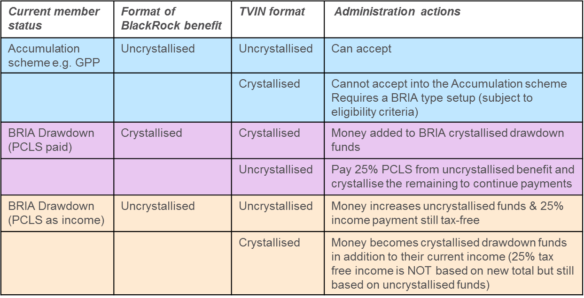
Accepting Uncrystallised and Crystallised Monies
As stated we must check whether the transfer-in is in respect of crystallised or uncrystallised benefits (this includes Pension Credits following divorce settlements)

Slide 10
Money Purchase Annual Allowance
If the transferring scheme is aware that a flexible benefit has been taken that has triggered the Money Purchase Annual Allowance they must tell the receiving scheme
Where we are the receiving scheme administrator we should ask for this information
If the transferring scheme does not confirm this, we assume that flexible benefits do not apply
If the transferring scheme confirms flexible benefits have been taken, we need to know the date then we will note this on our records & follow the MPAA process

Slide 11
Can a member change their mind?
GPP/Stakeholder
Cancellation period - member has 30 days following receipt of the transfer in which to change their mind & decide not to proceed. If cancelled we will attempt to return the money (current value) to the original scheme or transfer it to another
BlackRock Retirement Income Account
Period of Reflection - member has 30 days in which to change their mind once we receive the completed transfer-in application form
We will not request/accept the transfer-in payment until the end of this period
The member can waive this Period of Reflection in which case we will request/accept the transfer-in payment immediately after we have all our requirements
Occupational Pensions
No cancellation period/period of reflection

Slide 12
Transfer in and Enhanced Protection
Enhanced Protection – this was available to members at 5 April 2006 if they wished to protect their pension benefits from the lifetime allowance charge
Members benefits are not subject to LTA charge as long as the protection conditions are maintained post A Day
One condition concerns transfers - benefits can only be transferred if the transfer is a ‘permitted transfer’ A permitted transfer is one where:
The transfer is to a money purchase (DC) arrangement or
All benefits under a DB arrangement are transferred to a DB arrangement under another Registered Pension Scheme and:
The transfer has occurred in connection with winding up of the original scheme or
Where the transfer relates to a relevant business transfer e.g. a transfer of business from one company to another or
A retirement benefit activities compliance exercise. This relates to compliance with the Pensions Act 2004 and members who only have an entitlement for death benefits under the scheme. We are unlikely to come across this
If we are aware that a member transferring benefits to us has Enhanced Protection, we need to confirm that the transfer is a permitted transfer
The same applies to members with Individual Protection 2014/16 & Fixed Protection 2012/14/16

Slide 13
Block Transfers
Protection of pre A Day rights – this was available to members at 5 April 2016 such as the right to receive >25% lump sum or take benefits before age 55
Protections are scheme specific & normally lost if the member transfers their benefits
Protection can be transferred to another scheme if the transfer meets the ‘Block Transfer’ conditions
What is a Block Transfer?
The transfer in a single transaction of all the sums and assets representing accrued rights under the scheme from which the transfer is made which relate to the member and at least one other member of that pension scheme
A single transaction means:
all of the sums and assets must be transferred from the transferring scheme to only one receiving scheme
the transaction must be made under a single agreement for a single transfer between the two schemes
All of the funds do not have to be physically transferred on the same day but must be transferred within a reasonable timeframe & be part of same agreement
Transfer can be made to any Registered Pension Scheme, providing member was not a member of the receiving scheme for > 12 months at the time of transfer
Where a scheme winds up & benefits are transferred to S32s - treated as Block Transfers even though each Section 32 is a separate Registered Pension Scheme and the assets of two members are not being transferring into one scheme

Slide 14
Summary for Contract Based Schemes
Transfer In from: | We accept? | Comments
UK Registered Scheme | Yes (but crystallised benefits can only be paid into our Drawdown plans) | GPP - advice required if transferring in DB benefits
UK Non Registered Scheme | No
QROPS | Refer to Technical Support
Overseas non QROPS | No
NOTE: Trust Based Schemes – Acceptance of any transfer is the Trustees decision so check Flashcard
Notes:
Trust Based schemes check Flashcards depend on scheme

Slide 15
Transfers In
Summary
The Right to Transfer In (Scheme decision apart from SH)
Transfer In from Overseas Pension Schemes (contract based refer to Technical Support)
Our Confirmation Requirements (registered scheme, DB/DC, crystallised benefits, divorce, protection)
Drawdown Arrangements Pre-April 2015 (can accept into BRIA)
Transfers In to BlackRock Retirement Income Account (must meet criteria to set up BRIA, BRIA can accept crystallised & uncrystallised)
Accepting Uncrystallised and Crystallised monies (Accumulation only uncrystallised)
Money Purchase Annual Allowance (ask transferring scheme re flexible benefits)
Can a member change their mind?(Period of Reflection/Cancellation Period 30 days)
Transfer In and Enhanced Protection (permitted transfer e.g. DC to DC)
Block Transfers (to keep PTFC or protected retirement age)
Summary for Contract Based Schemes
Quiz

Slide 16
Thank you
Karen Gore
E: Karen.gore@aegon.co.uk
T: 01733 255237

